Slide 1
Rethinking NHL Goalie Scouting: An AI-Driven Analysis Challenging Conventional practices
By Abbie Ives

Slide 2
Personal Background & Reason for Project
Project Inspiration: My career goal is to work for an NHL team’s analytics department. I believe this project could demonstrate value I could bring to a department.
Expert Knowledge: My expert knowledge of hockey comes from extensive experience as an NCAA Division 1 player & coach, and as a professional hockey goalie.
Extremely Valuable Subject Matter: In hockey, goaltending is both extremely consequential to outcomes and very obscure--since it is objectively different than any other position. Capturing insights on this position is extremely valuable to any team.

Slide 3
Motivation & Problem
NHL Teams Inconsistent Success in drafting goalies: ”The teams that have the best goaltenders almost always acquired them through the draft but finding that player is one of the most difficult tasks general managers face.”-Josh Beneteau, SPORTSNET
My Theory: The difficulty NHL teams have drafting goalies that will actually be assets to their organization is a result of ineffective goalie scouting processes.
How I Will Prove It: The aim of this project is to use Natural Language Processing to illuminate certain flaws in the NHL’s current scouting process for goalies.

Slide 4
Method/approach
1. Data Collection & Labeling
• Collected scouting reports for all NHL goalies drafted (2010–2020) from TheHockeyWriters.com
• Assigned success labels based on career NHL games played:
– Elite, Successful, Average, or Unsuccessful
2. Text Processing (NLP)
• Cleaned reports: removed punctuation, numbers, and stopwords (including hockey terms)
• Converted text to numerical features using TF-IDF vectorization
3. Model Training
• Trained a Logistic Regression model on scouting report text
• Used a 70/30 train-test split
• Evaluated with: Accuracy, Precision, Recall, F1-score
4. Clustering & Embeddings
• Used sentence embeddings to measure report similarity
• Applied K-Means clustering to group reports into 3 clusters
• Analyzed cluster composition by success label

Slide 5
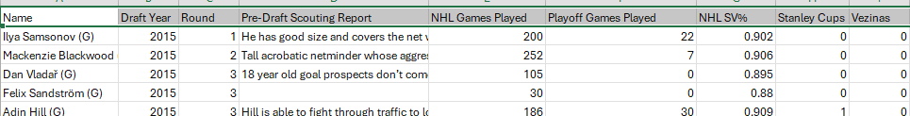
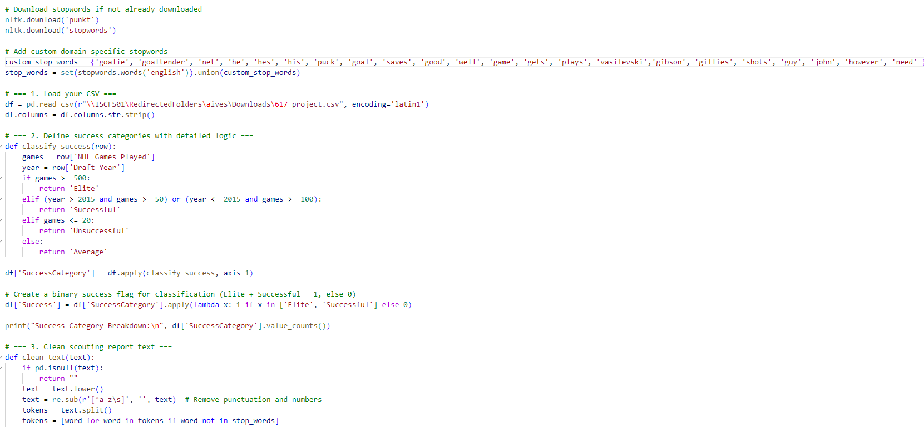
Implementation/ and Dataset
Dataset
• Pre-draft scouting reports for NHL goalie prospects from 2012-2020
• Includes metadata: Draft Year and NHL Games Played, Career Save%
• Source: The Hockey Writers – quotes from NHL scouts for consistency
Data Processing
• Cleaned text: removed hockey jargon and filler words that weren’t meaningful
• Labeled goalies into 4 success categories based on career outcomes:
– Elite (500+ games)
– Successful
– Average
– Unsuccessful (≤ 20 games)
Analysis Pipeline
• Used TF-IDF vectorization to extract numerical text features
• Generated sentence embeddings (SentenceTransformer) for semantic similarity
• Applied K-Means clustering to group similar scouting language
• Trained classification models to predict goalie success from text
• Analyzed common terms by success category and visualized trends over time
Purpose
• To test whether scouting language meaningfully predicts goalie success
• Explore how pre-draft evaluations align with actual career outcomes

Slide 6
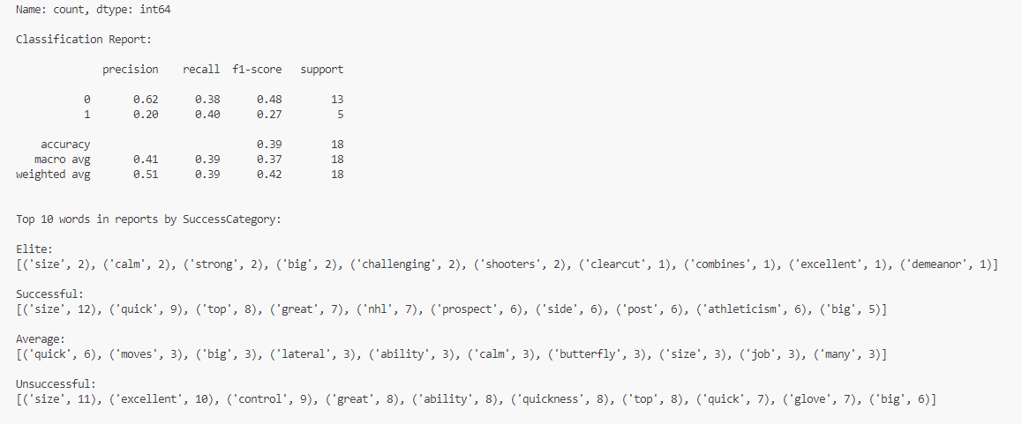
Results
Success Category Distribution
Unsuccessful: 25
Successful: 23
Average: 8
Elite: 2
Classification Performance
Accuracy: 39%
F1-score (Successful): 0.27
F1-score (Unsuccessful): 0.48
Top Words by Category
Elite: calm, strong, size
Successful: quick, nhl, prospect
Unsuccessful: control, glove, quickness
Cluster Breakdown
Cluster 1: Most Successful players (23), also 28 Unsuccessful
Cluster 0 & 2: Small, mixed clusters with few Successful
Metric | Measurement | Target | Actual
Audience attendance | # of attendees | 150 | 120
Engagement duration | Minutes | 60 | 75
Q&A interaction | # of questions | 10 | 15
Positive feedback | Percentage (%) | 90 | 95
Rate of information retention | Percentage (%) | 80 | 85

Slide 7
Results continued-WHAT IT MEANS
Theory: My theory is based on the idea that scouting reports should be predictive of NHL success, there should be qualities captured in these reports that at least somewhat differentiate goalies that make it to the NHL and goalies that don’t.
Results Meaning:These results suggest that NHL pre-draft scouting reports do not reliably capture qualities that predict goaltender success. Despite using natural language processing and classification techniques, the model achieved only 39% accuracy and low F1-scores, indicating poor predictive power. Moreover, the most common descriptors—such as "quick," "big," "strong," and "calm"—appear across all success categories, including both successful and unsuccessful goalies. The clustering analysis further supports this, as each cluster contained a mix of both outcomes, with no group clearly distinguishing future NHL success. This implies that the language used in these reports lacks the specificity or consistency needed to identify which prospects will become successful professionals.
Major Insight Gained: I am making an expert assumption that there ARE discernable qualities between goalies that will be successful in the NHL and goalies that wont. What this model tells us is that the current process used to evaluate goalies does not capture these qualities.
Expert Observation: In my expert opinion, patience is an extremely important discerning quality for NHL success, that word appears only once in these scouting reports—further illuminating the issue of current scouting processes.
Recurring Language: Athleticism, size, and quickness are essentially meaningless qualities to capture. To be drafted to any professional sports league, you need to possess those qualities. My model provides strong evidence that the process for evaluating goalies needs to be rethought.

Slide 8
Challenges & limitations
Only publicly accessible data: My theory makes the inference that the scouting reports obtained resemble the scouting reports that actual teams are using but it is impossible to be sure of that inference without access to those reports.
The data set does not capture every single goalie drafted during this time frame, some goalies drafted did not have draft profiles with the website I used for this project and thus were not in my dataset
The work to prove my point further hasn’t been done yet but I believe I could accomplish a more accurate evaluation tool while working for an NHL team.

Slide 9
Future work
-I believe this would be a great project to show to NHL GM’s and Analytical Departments to start a conversation on how the process of goalie scouting can be improved and rethought
-From my own expertise on goaltending I can provide numerous ideas on how scouting can be improved
-Useful context would also be the same study done with different positions and different sports that are better understood

Slide 10
Thank you
Q & A

